Slide 1


Team Name : Concept Crew
Team Leader Name : Shivansh Tripathi
Team member Name: DEEPANSHU
Problem Statement : Transforming digital behaviour into loan eligibility for the next billion users.

Slide 2

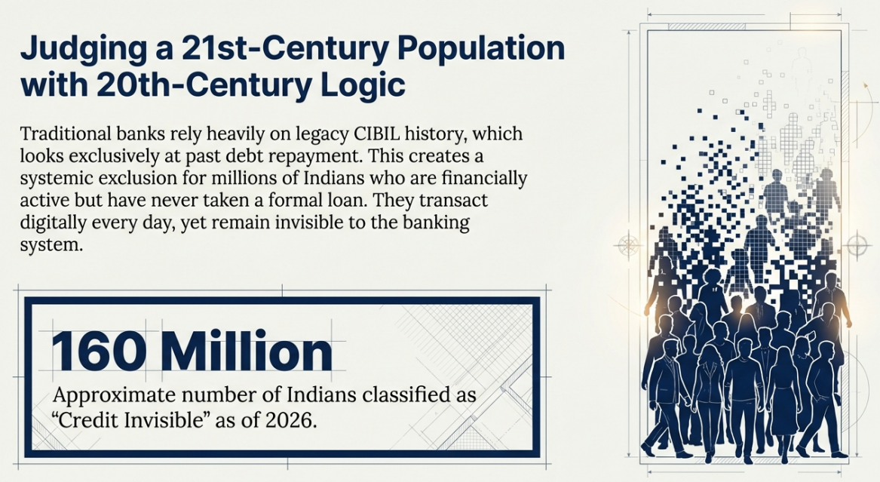

Slide 3
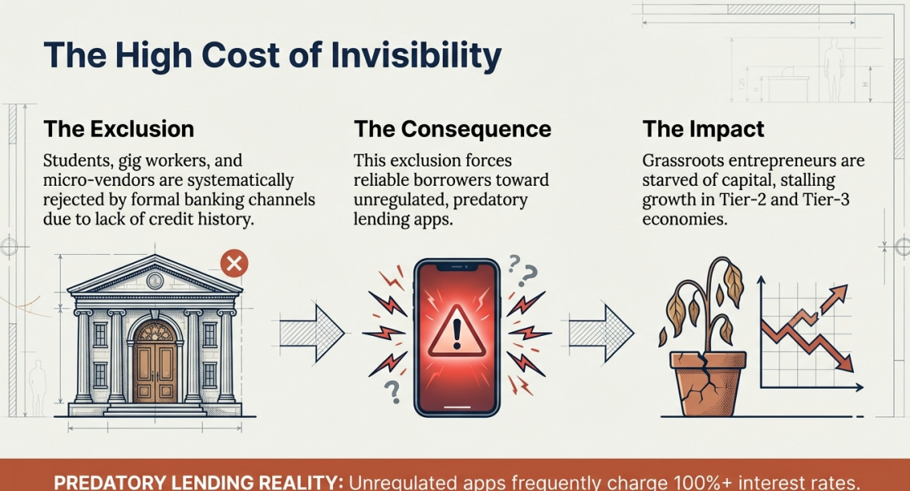

Slide 4
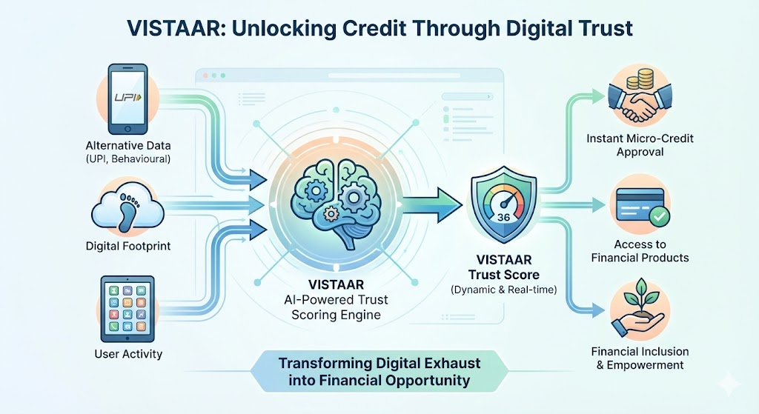

Slide 5
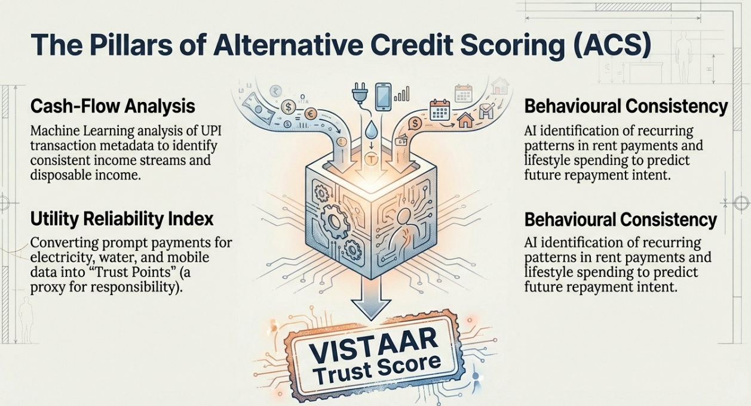

Slide 6
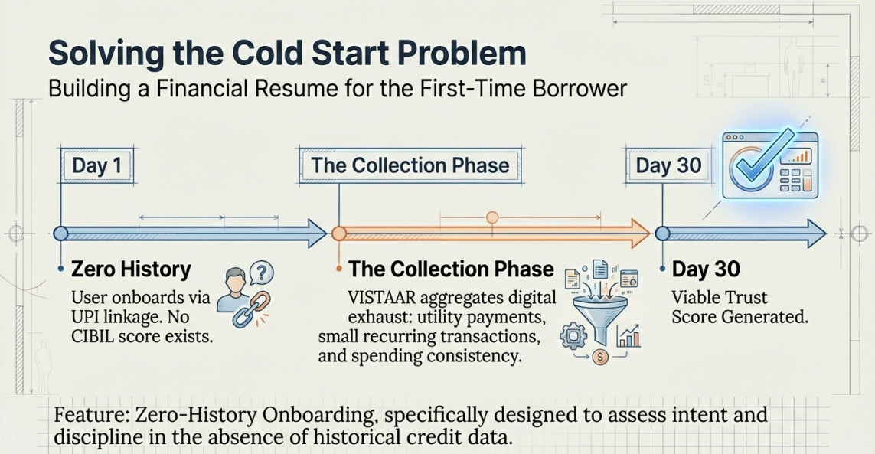

Slide 7
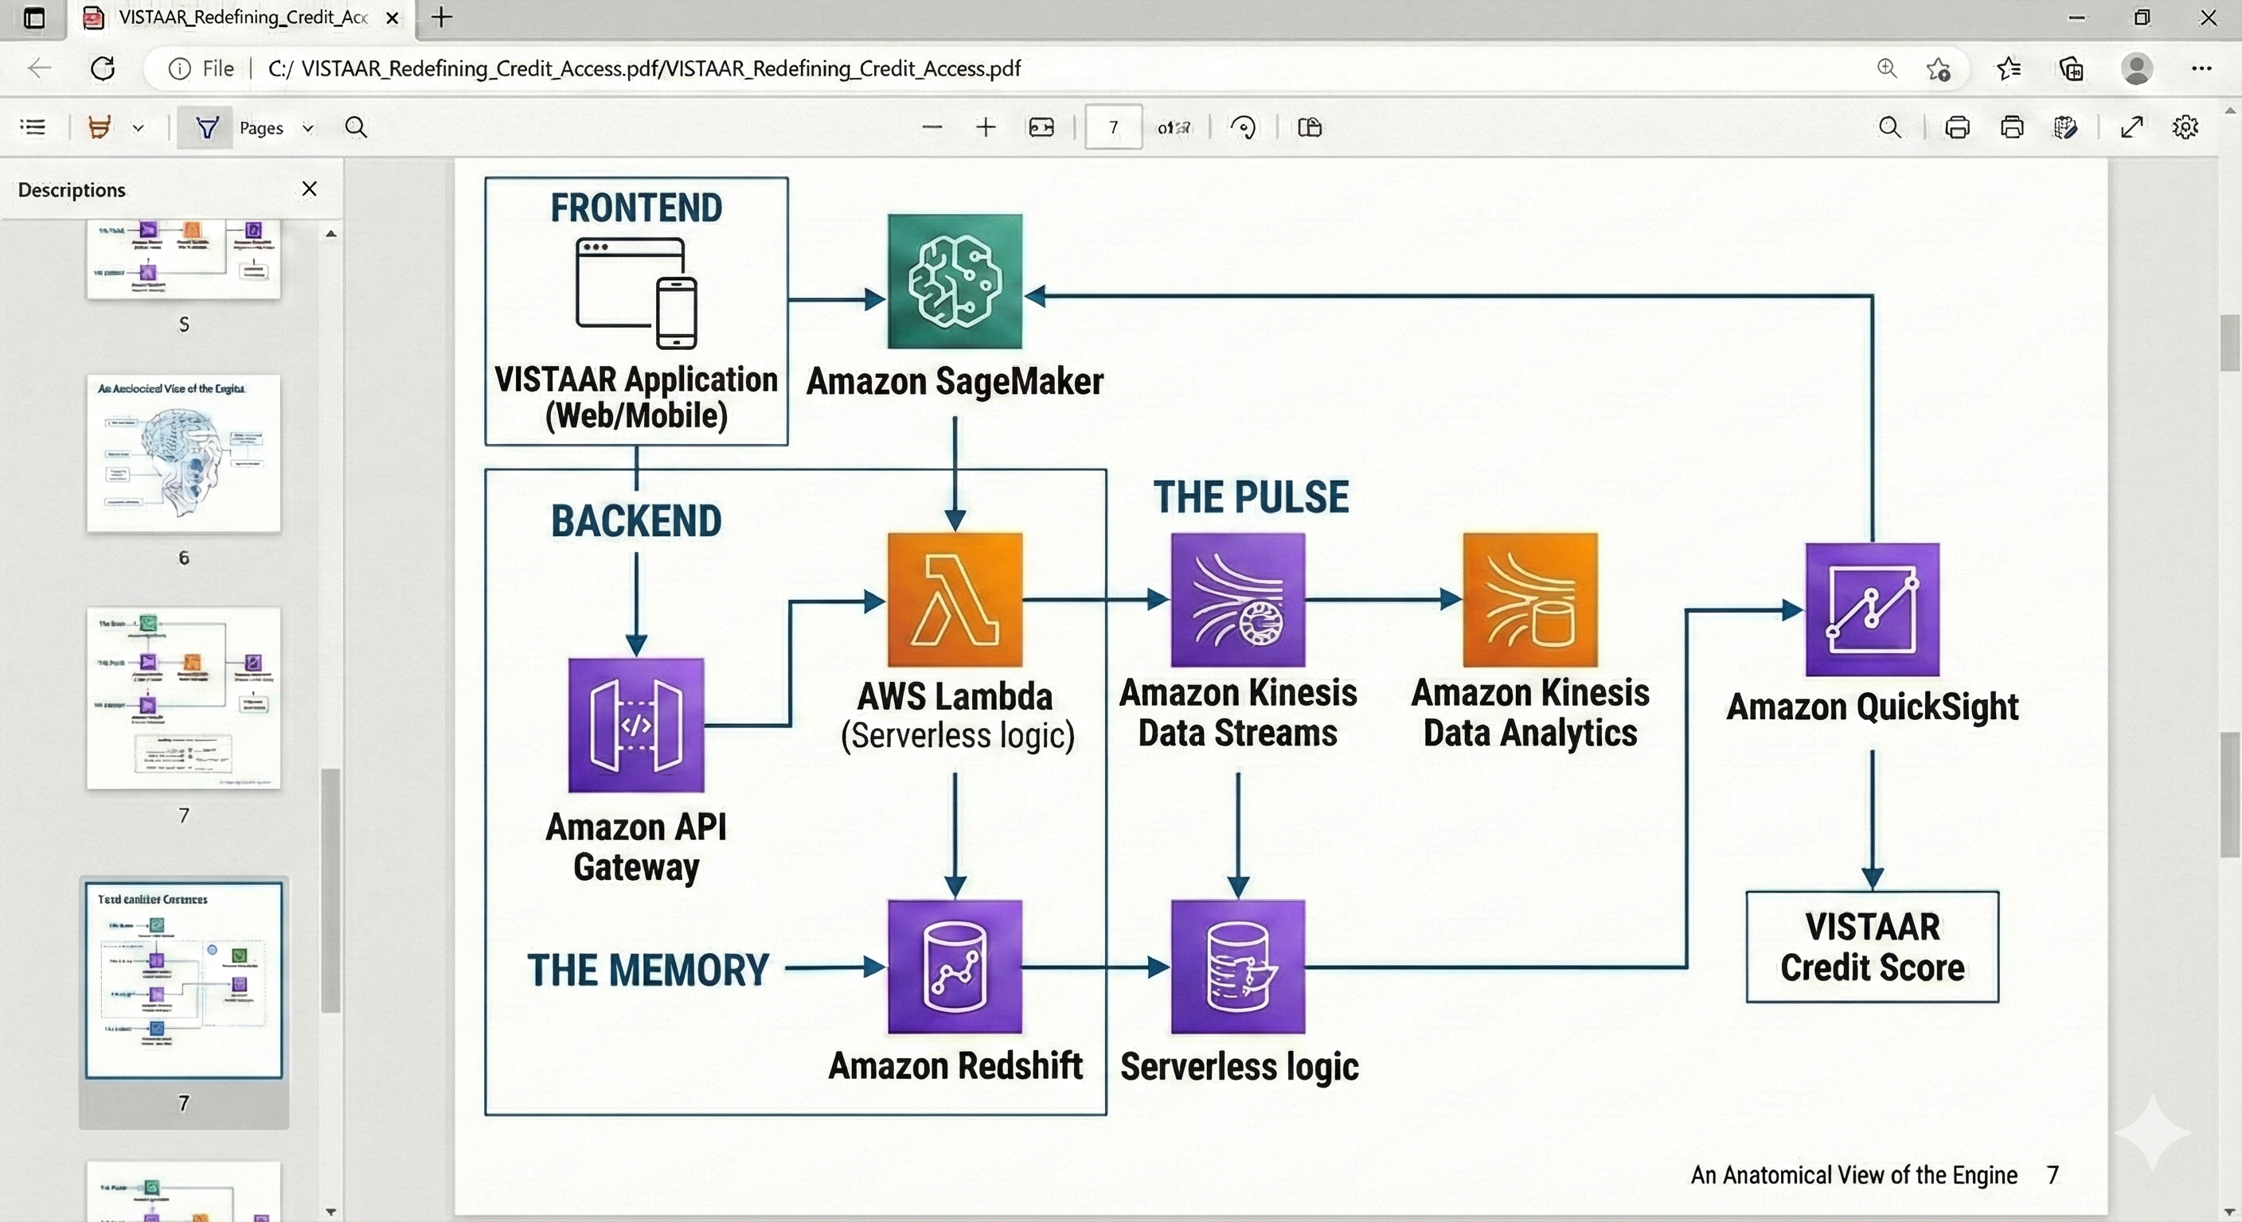

Slide 8
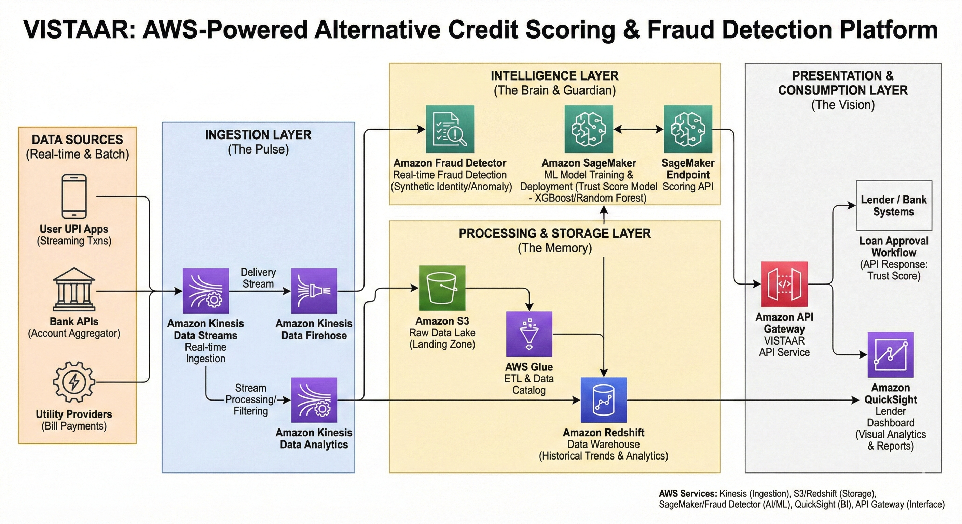

Slide 9


Slide 10
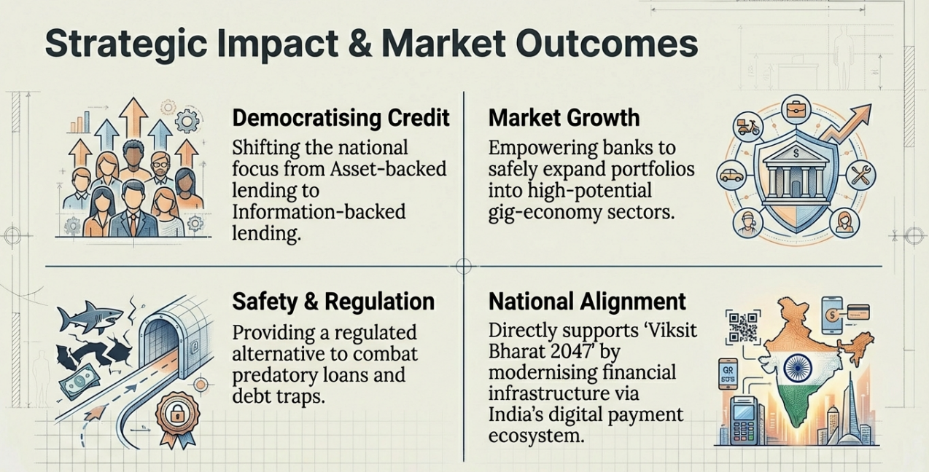

Slide 11


Slide 12


